Slide 1

Response To RFP APPLICATION SOFTWARE FOR PROCUREMENT AND INVENTORY MANAGEMENT (EXTENDABLE TO HR & FINANCE MODULES) - Nortcele Systems
By Team Nortcele Systems
Ashok Kumar
VT Raghu
Date : 11-07-2024
Version : 1.0

Slide 2
S3 App Features
Onboarding (User Registration)
Visitor Management
Service Request (Helpdesk)
Material Movement
Invoices
Amenity Booking
Child Security
Notification

Slide 3
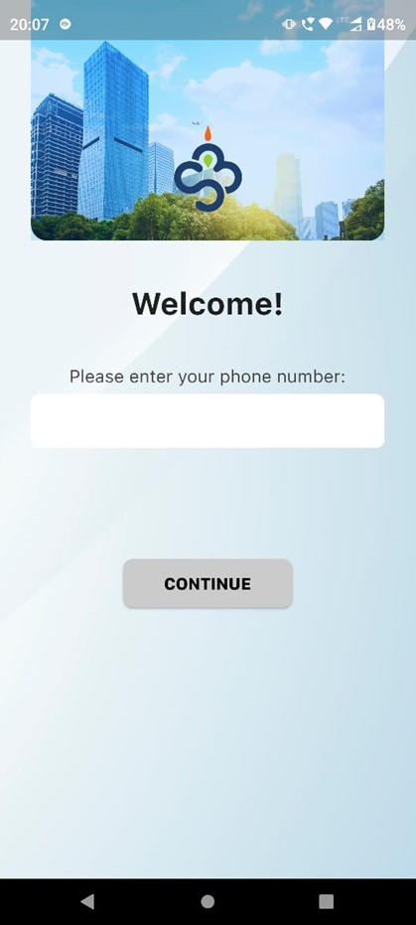
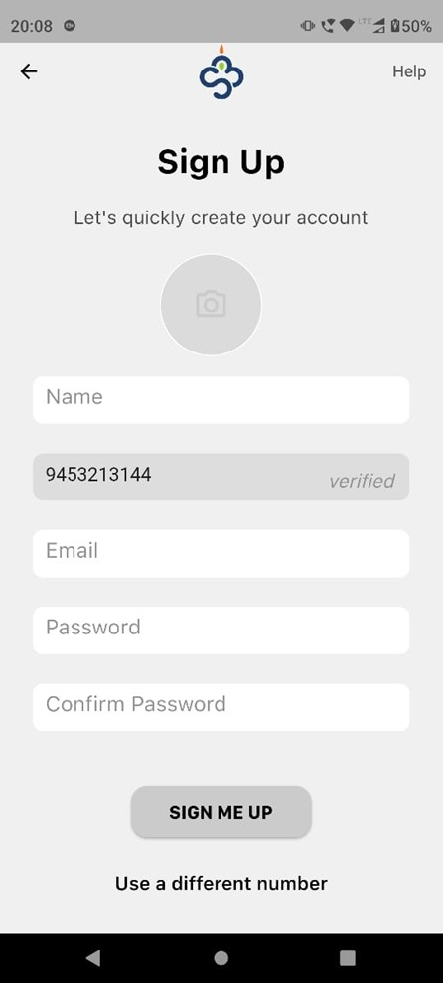
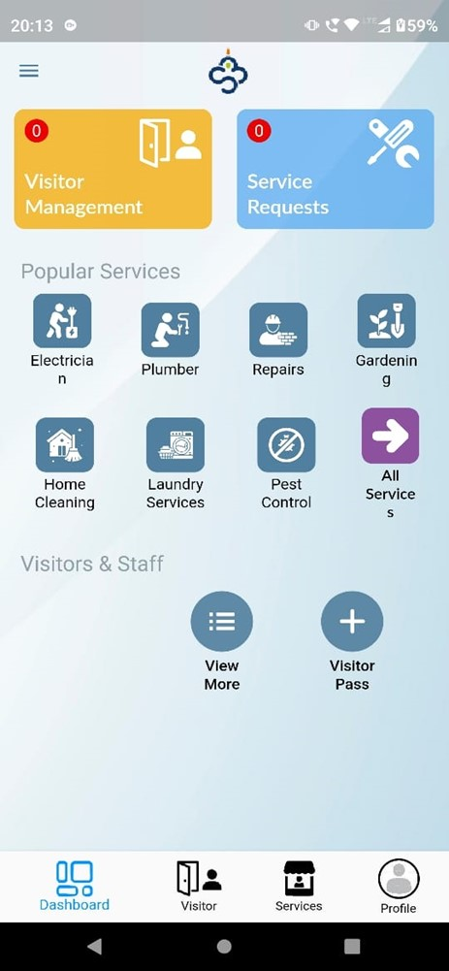
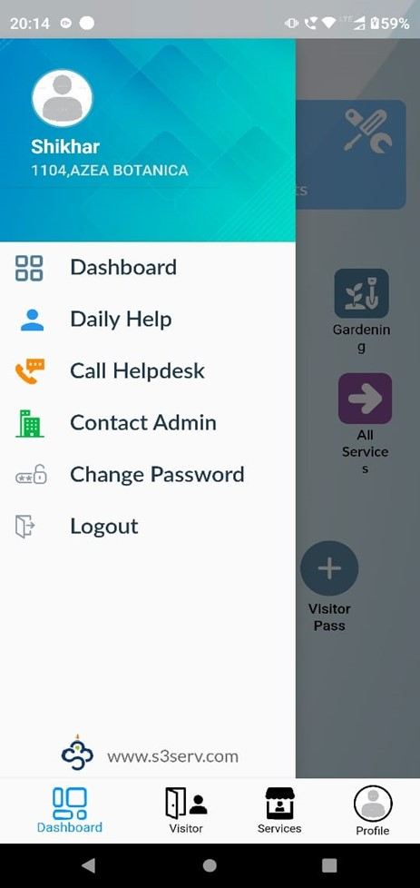
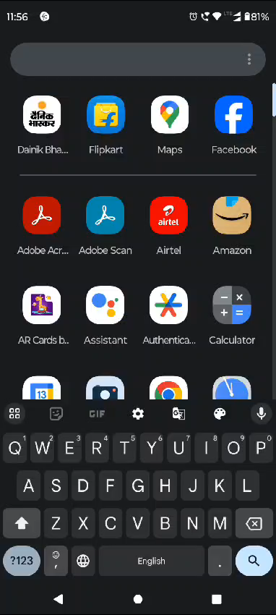
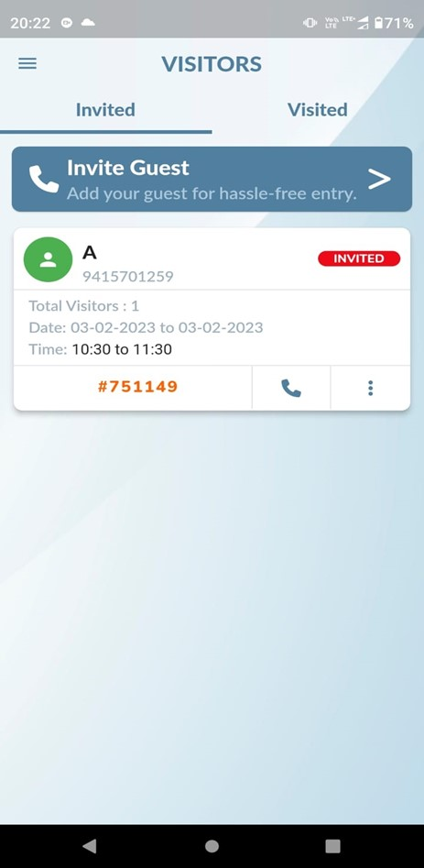
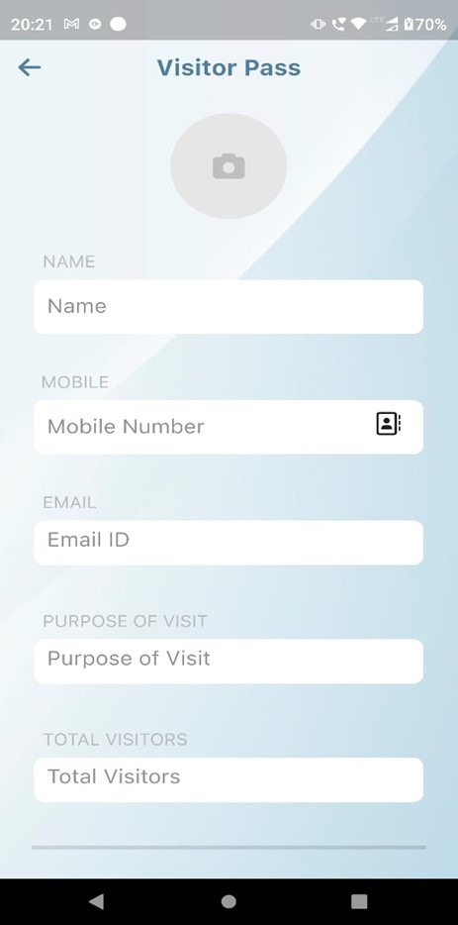
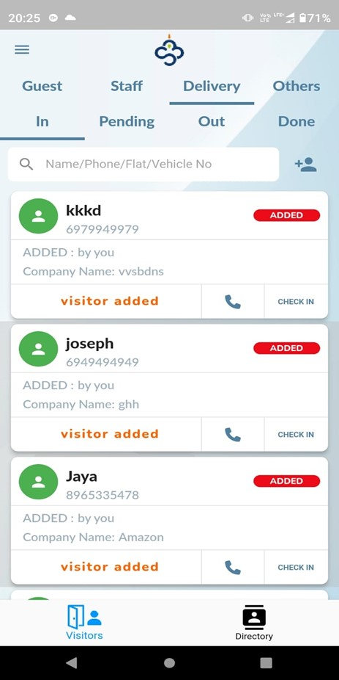
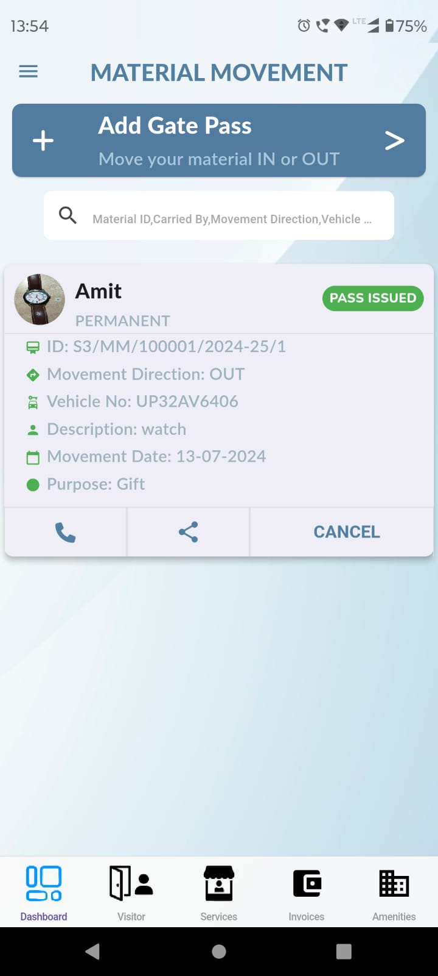
S3 App on Play Store

Slide 4
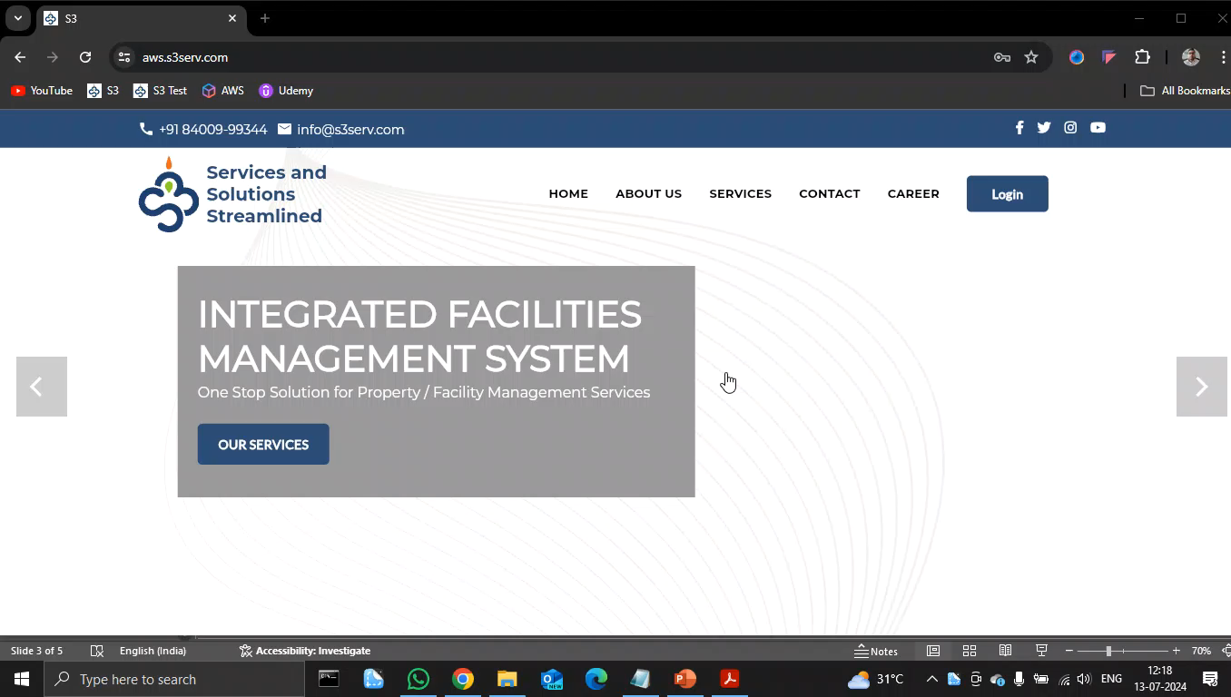
S3 App – Admin Dashboard

Slide 5
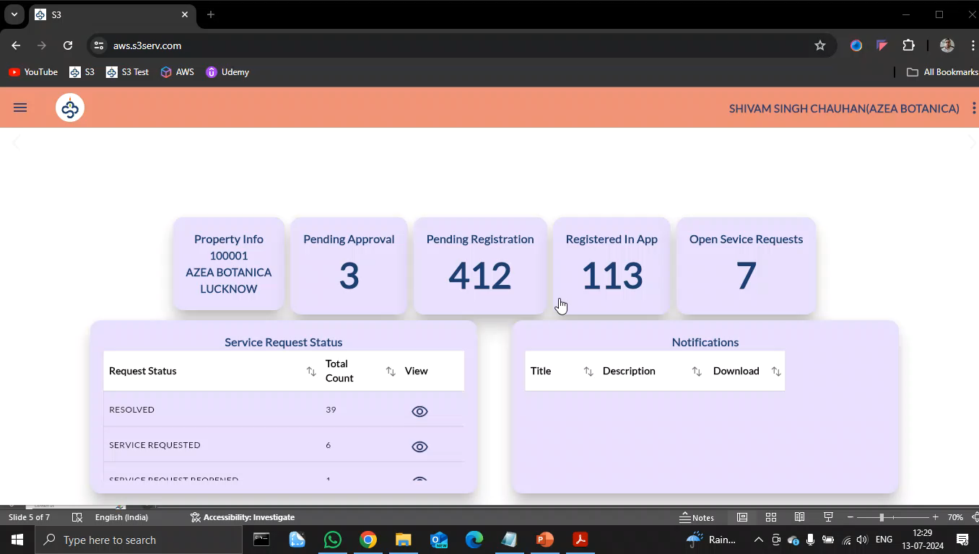
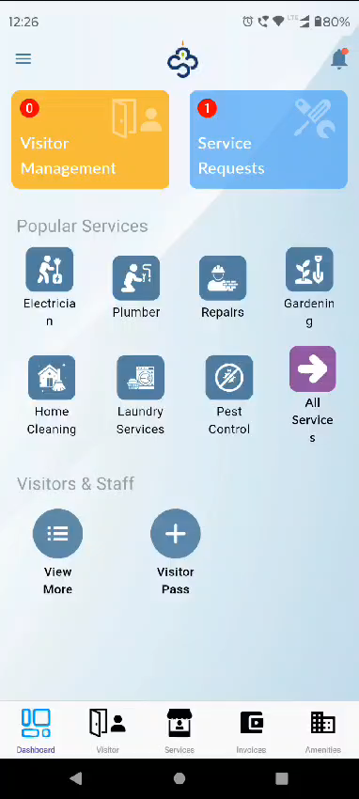
S3 App – Material Movement

Slide 6
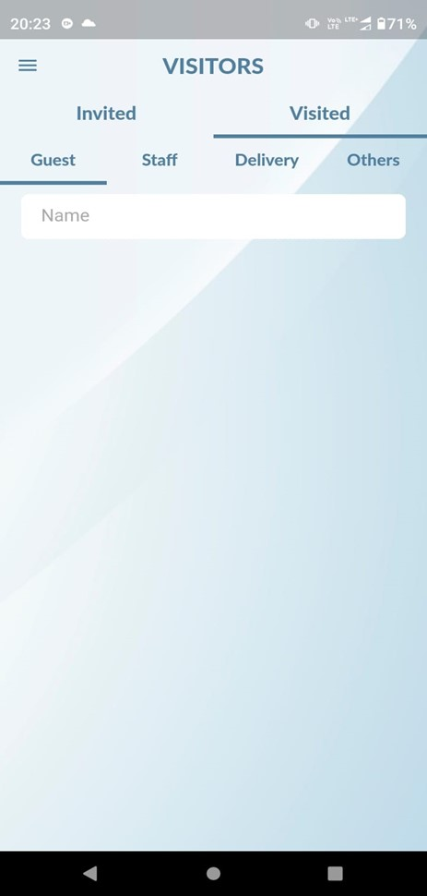
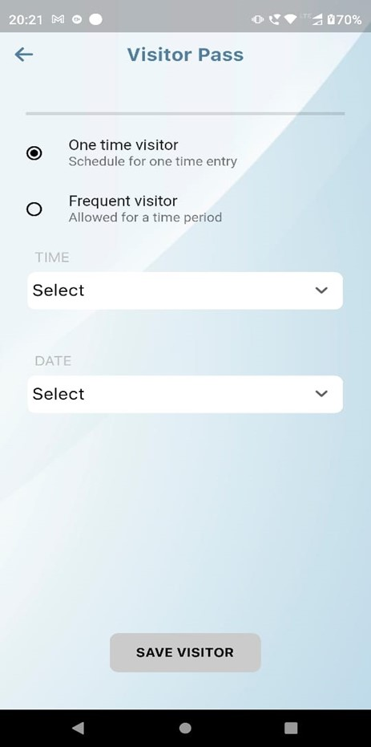
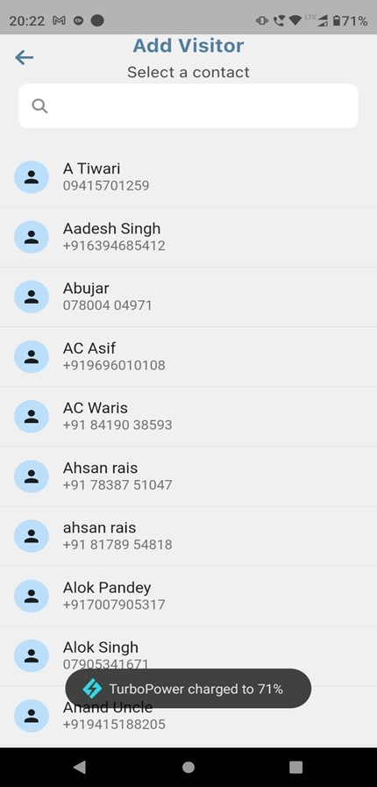
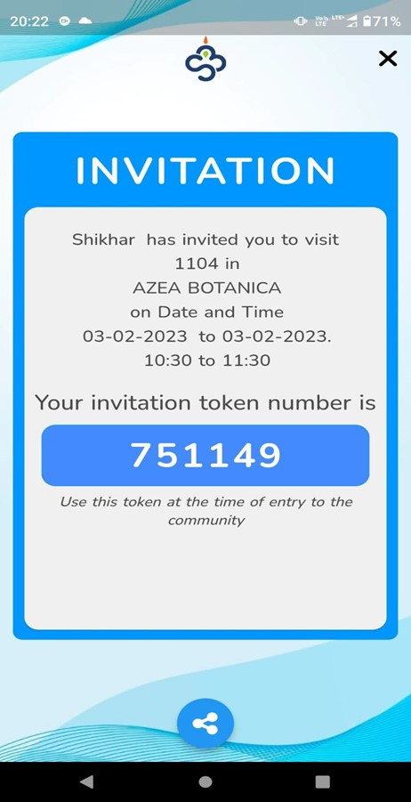
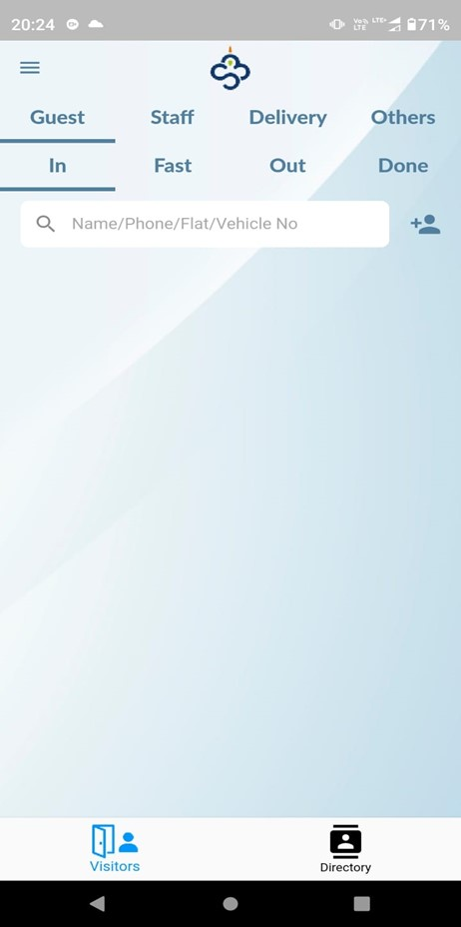
S3 App – Visitor Management

Slide 7
HMS Web Application Features
Dashboard
Billing
Appointment
OPD
IPD
Pharmacy
Pathology
Radiology
Blood Bank
Ambulance
Visitor Management
Finance
Inventory
Reports

Slide 8
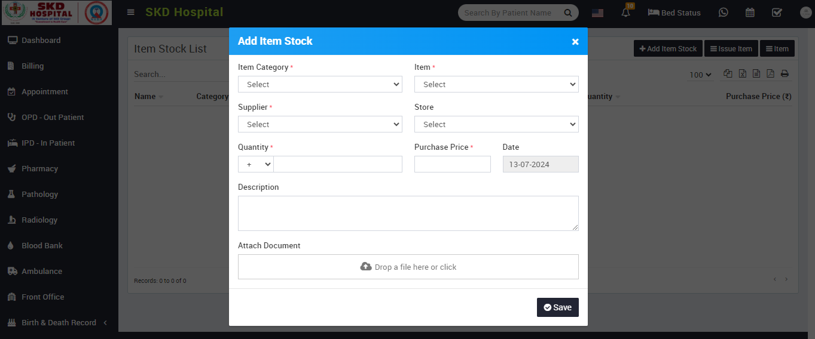
HMS Web Application - Inventory

Slide 9
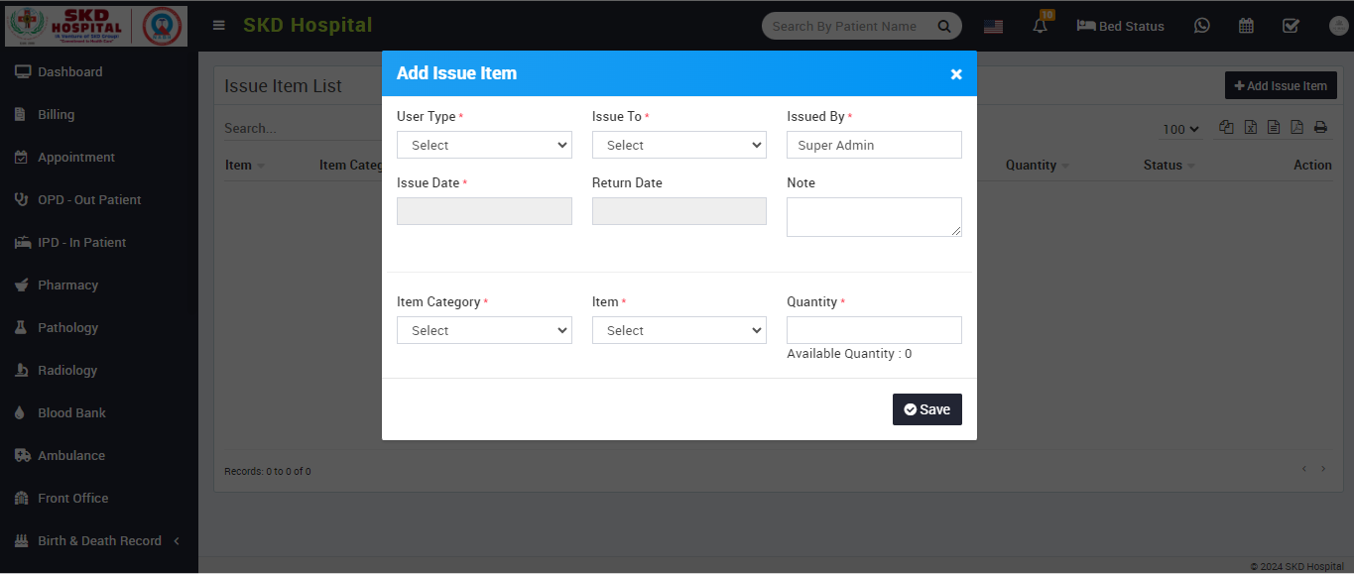
HMS Web Application - Inventory

Slide 10
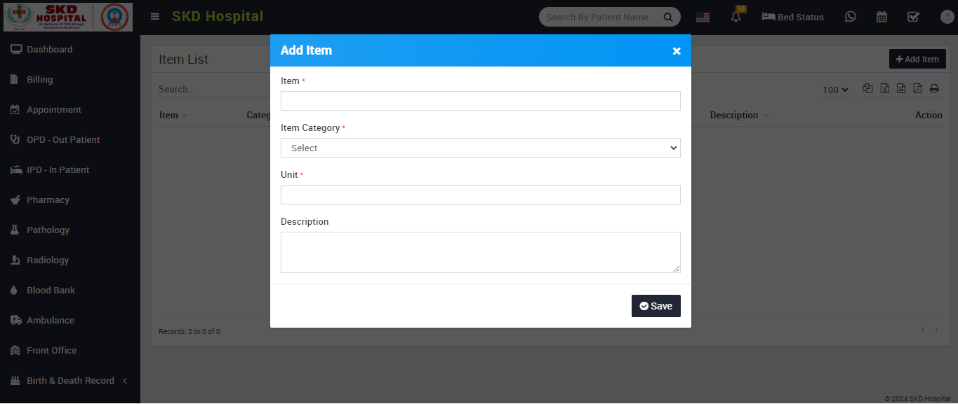
HMS Web Application - Inventory

Slide 11
Contact us
Presented By – Team Nortcele Registered Address:
92, Ist Floor, Natraj building, Near SNS Arcade, Konnena , Old Airport Road, Bangalore 560017
www.nortcele.in
Mobile : +91 9886422528
email: aks@nortcele.in

Slide 12
Team Nortcele Systems
Thanks

